Slide 1
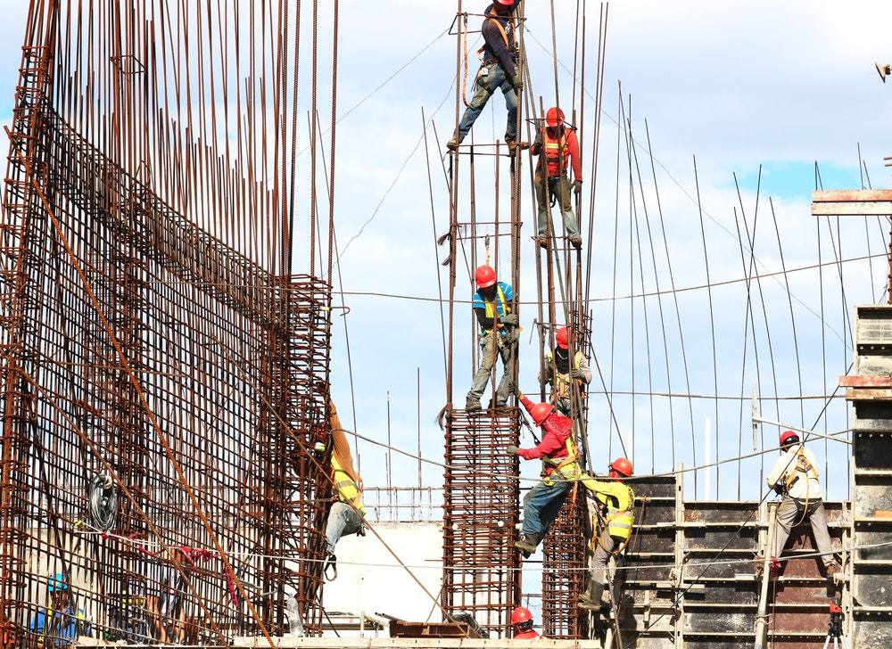
A PROJECT of Cse326 “CONSTRUCTION WEBSITE”
SUBMITTED BY:
Vishal(11808850)

Slide 2

INTRODUCTION
Construction website of company is used to know about the status of company and Employee can use it for company’s marketing.
User can be able to see projects.
User can be able to contact the Employee of Construction Company.
Employee can login with User id and Password to check quiere and can answer about it.
User can see the achievements done by company and the achievements as well.

Slide 3

Consumer’s Use-
User can open this website freely.
User can see the project videos , About, Contractor’s details, achievements and location of the offices.
If User want to know about anything user can be able to directly contact with Employee.
This website make easier for user to find all the things in just one click.

Slide 4
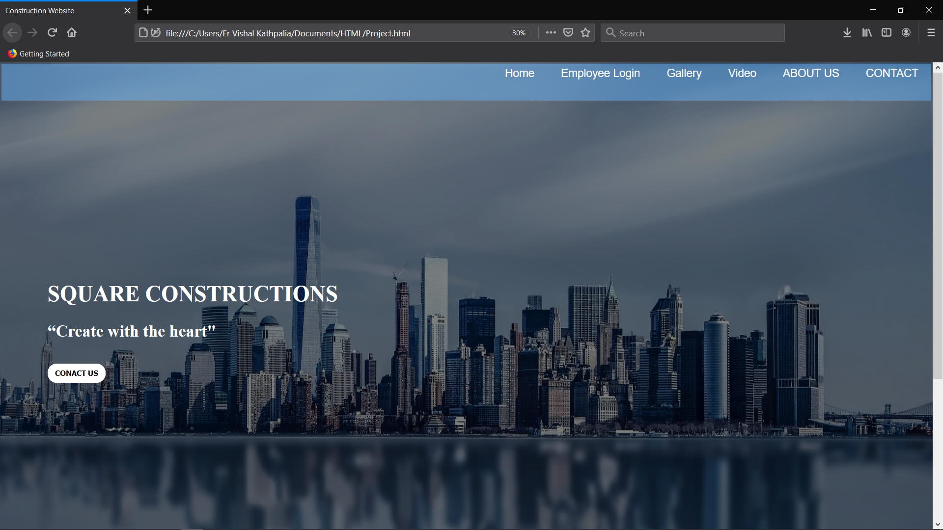
Homepage Of Website.

Slide 5
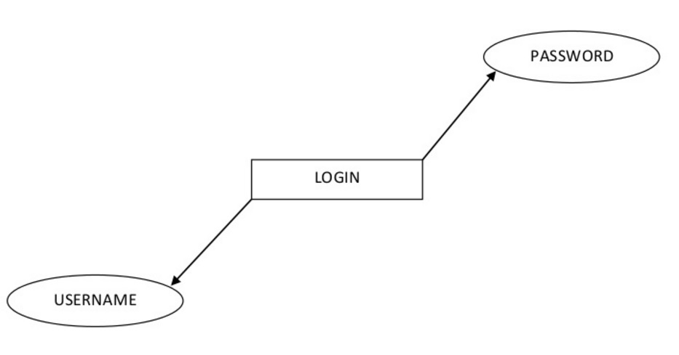
Employee’s Use Of Website-
Employee can Login In with Username and Password.
Employee can know the detail of consumer like Name, Email, Contact Number.
Employee will answer the quieres and it will make a bond between User and Employee.
So its make an easy for user so that they can compare two companies.
.

Slide 6
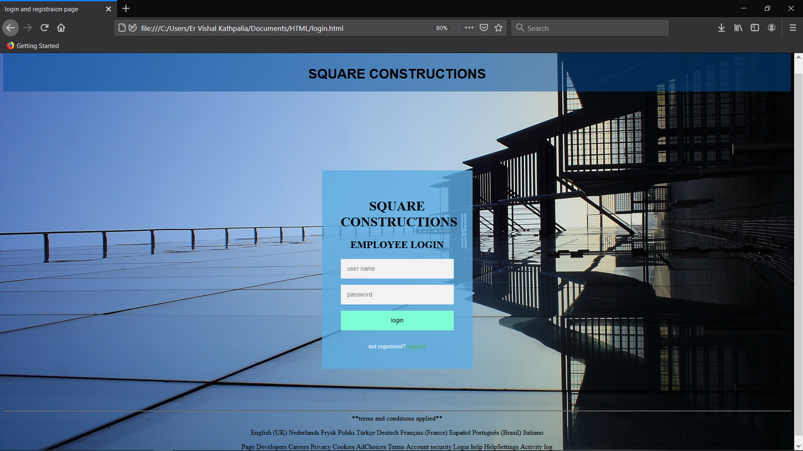
Login Page

Slide 7
What We Used.
HTML
CSS
Javascript

Slide 8
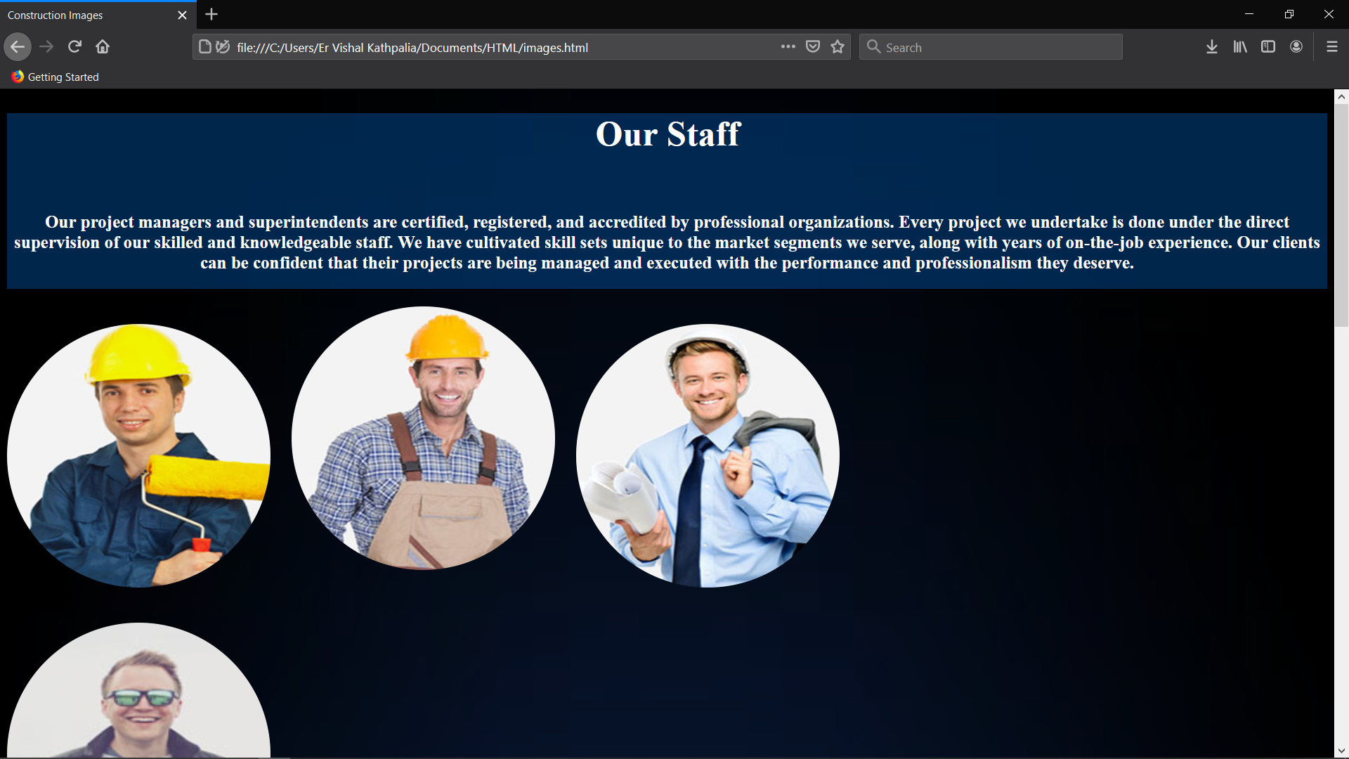
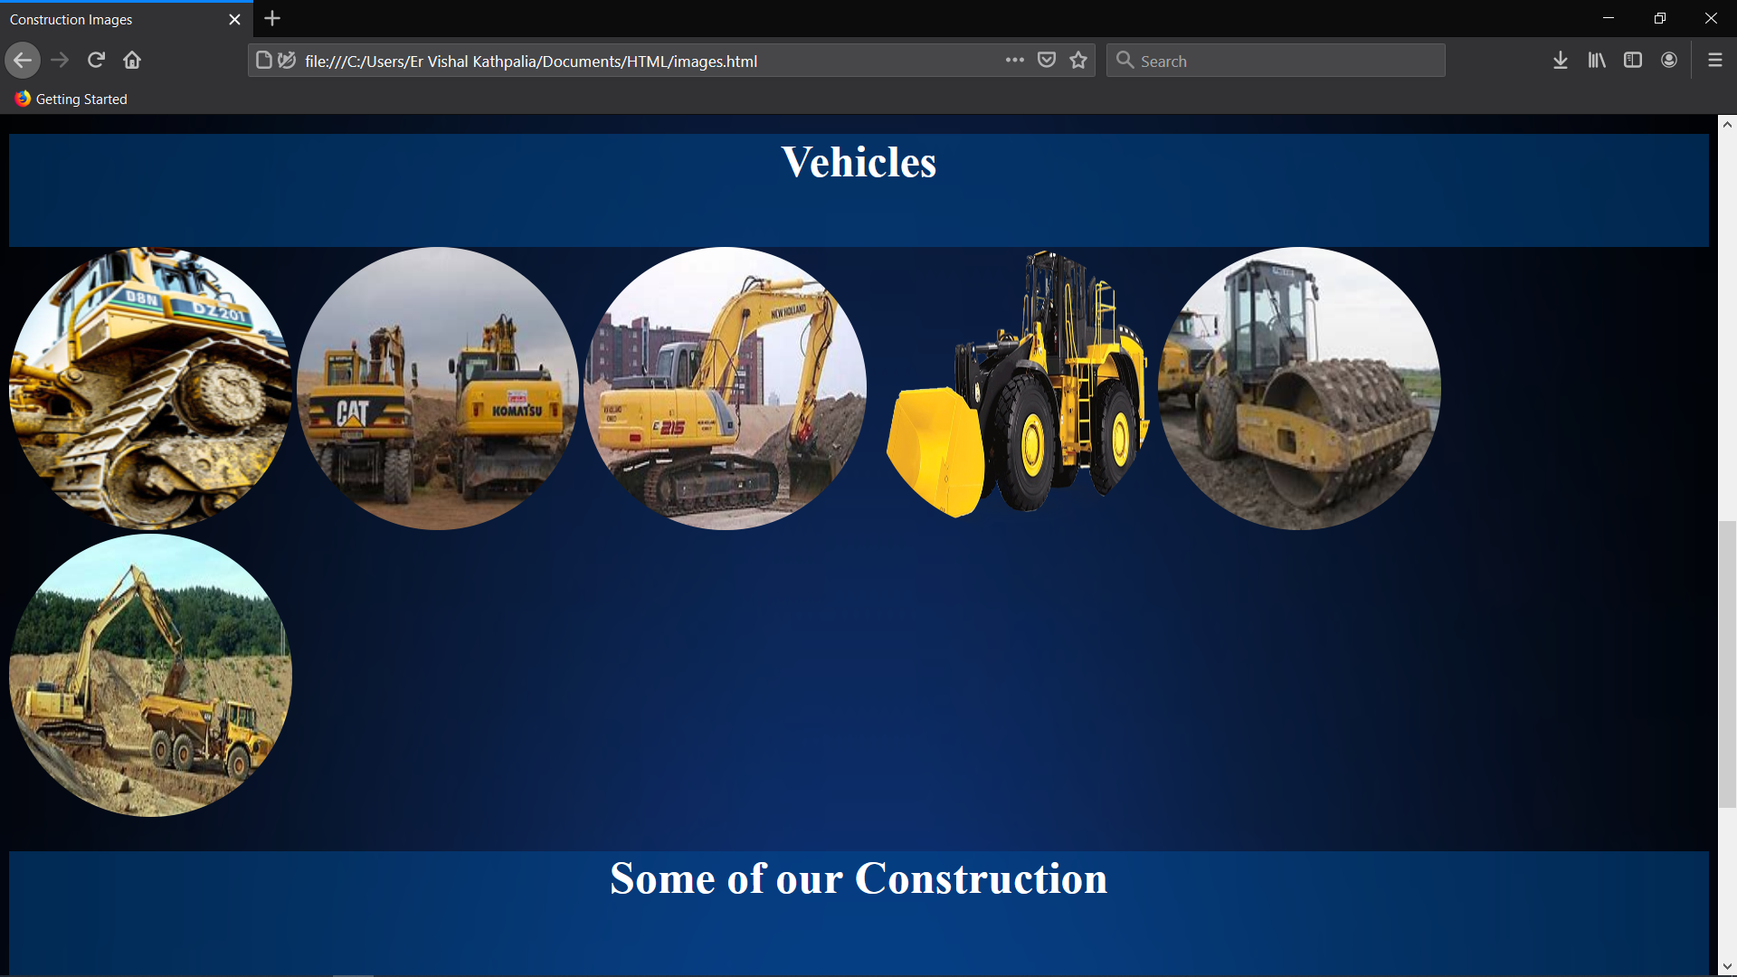
To Attract User
To attract user images and videos were added.

Slide 9
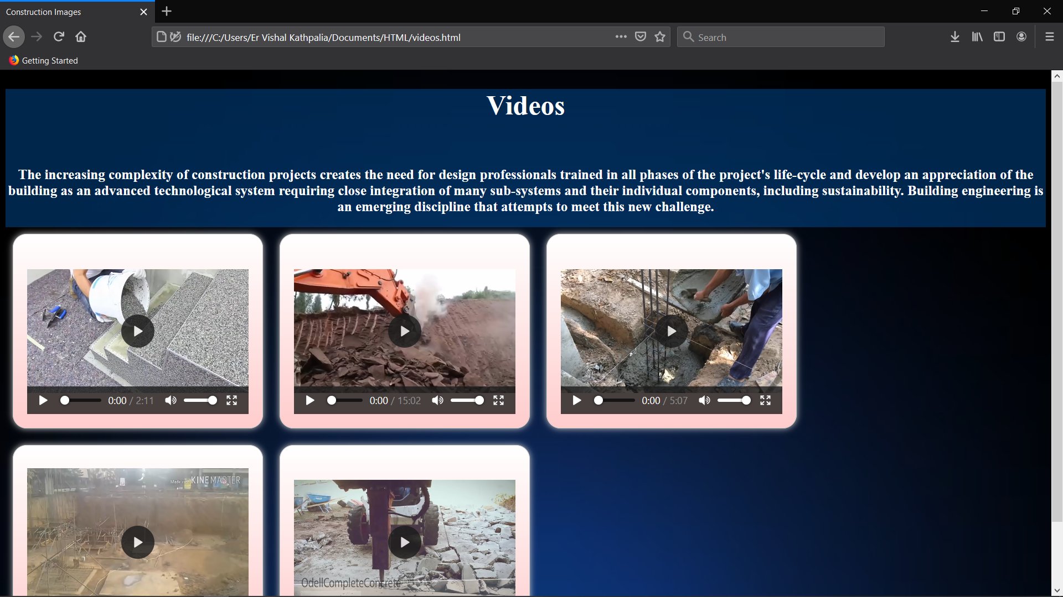
Videos
We Add the construction video it will make easier for user to see directly the work done by company.
.
.

Slide 10
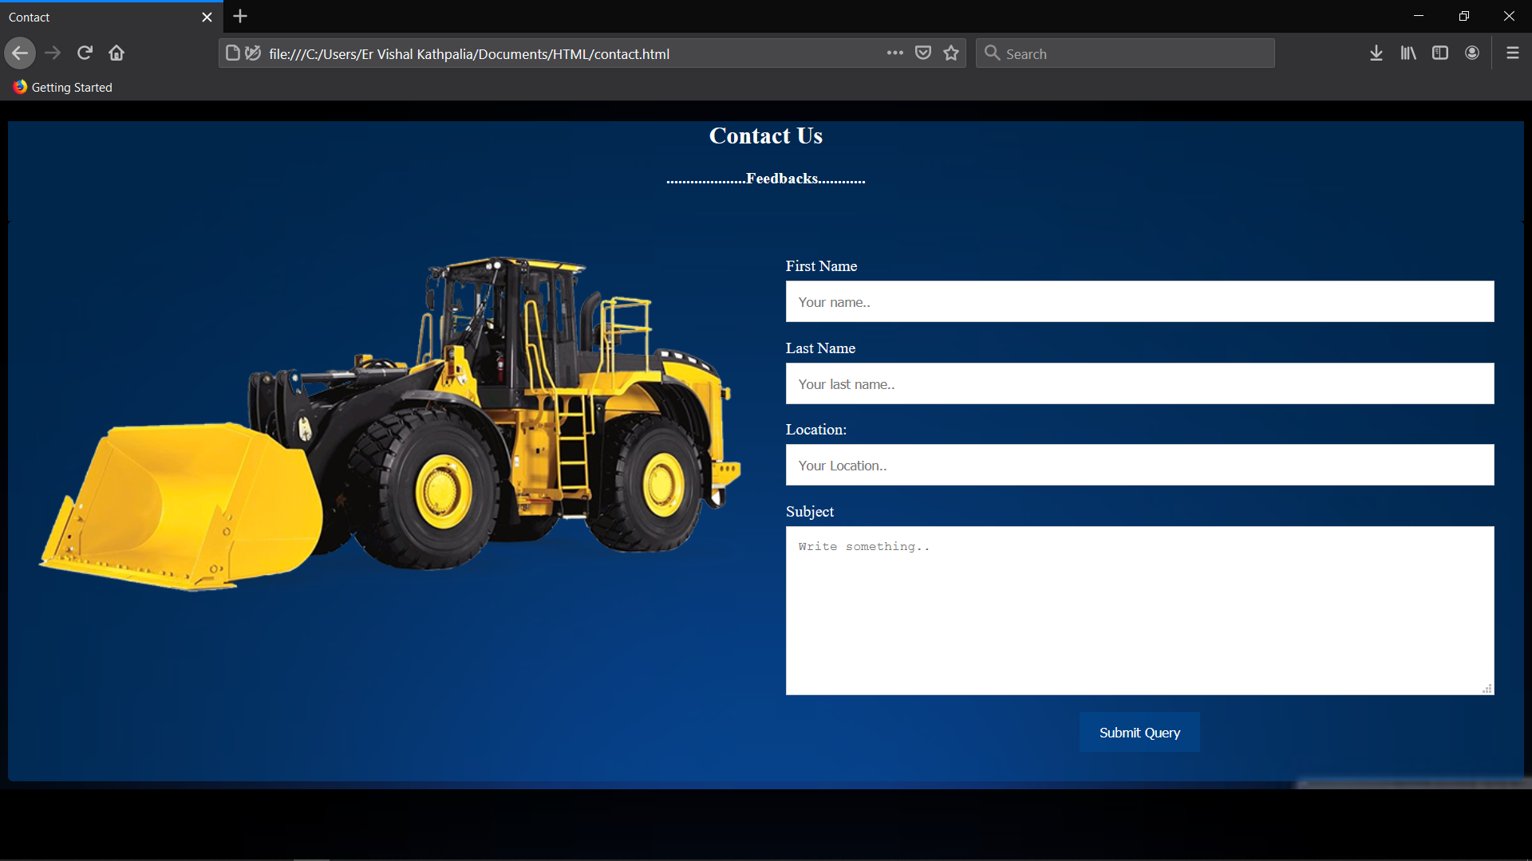
To Contact With The Employee-
To Contact with the employee the user must add the name and contact number with message as feebacks.
.
.

Slide 11
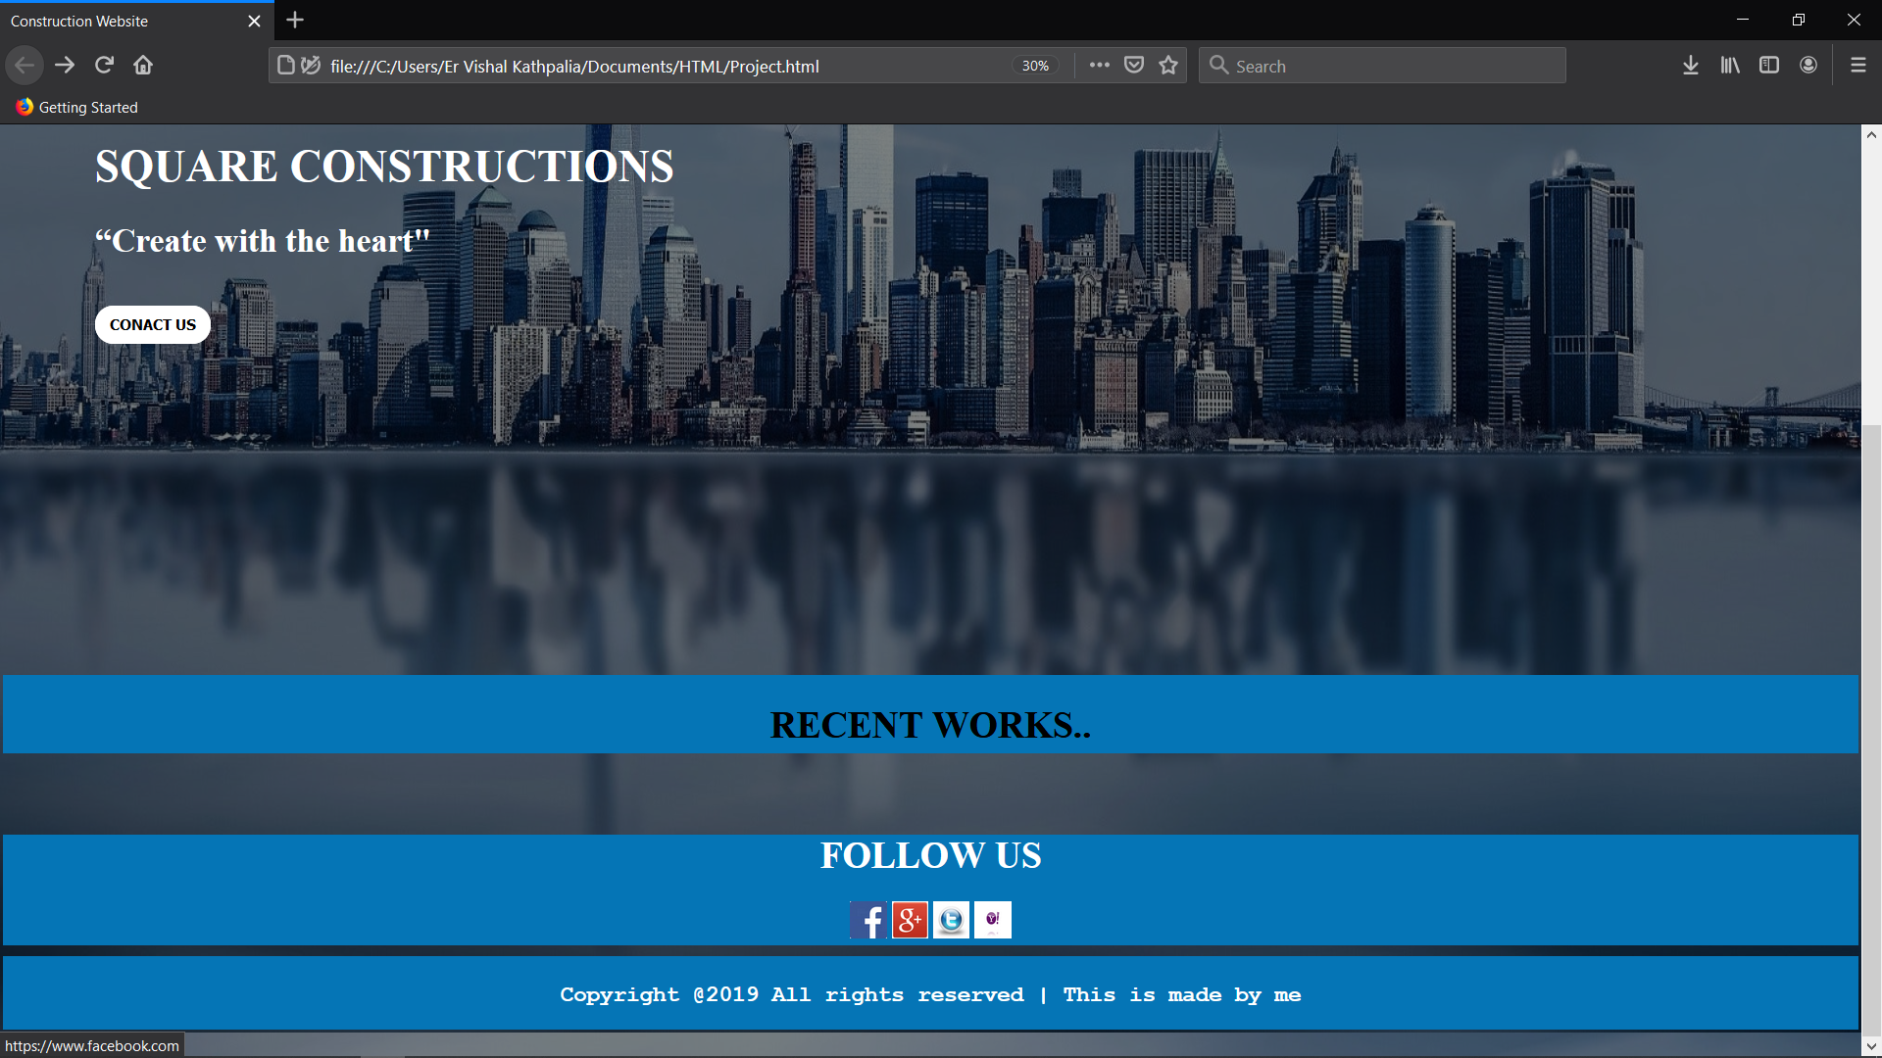
Social Media Links

Slide 12
ThankYou
.

